Slide 1

Sentiment Detection by Audio Files
This presentation delves into the exciting world of sentiment detection by analyzing audio files, demonstrating how data science can be applied to understand human emotions from speech. We'll explore a compelling Kaggle dataset, showcase the process of building a machine learning model, and examine its practical applications in various industries.

Slide 2
A Step-by-Step Journey: Building a Sentiment Detection System
Data Acquisition
Feature Extraction
Model Training
Evaluation and Deployment
We begin by acquiring a rich dataset of audio files labeled with various emotions. This dataset is crucial for training our machine learning model to accurately identify sentiment in new, unseen audio.
Next, we extract valuable features from the audio files, such as pitch, intensity, and timbre. These features capture the nuances of human speech, helping us understand the emotional content.
With the extracted features, we train a machine learning model. This model learns to associate specific feature patterns with different emotions, enabling it to classify sentiment in new audio.
Finally, we evaluate the performance of our trained model on a separate set of data to assess its accuracy. Once satisfied with the results, we deploy the model for real-world applications.

Slide 3

Exploring the Kaggle Dataset
Emotion Label
Number of Audio Files
Angry
1034
Disgust
1034
Fear
1034
Happy
1034
Sad
1034
Neutral
1034
This dataset consisted of 6522 audio files categorized into six distinct emotions: angry, disgust, fear, happy, sad, and neutral. Eventually after cleaning and removing outliers the total number of audio files came to 6204. This rich data provides a comprehensive foundation for training our model to accurately identify a wide range of human sentiments.

Slide 4
Data Preparation: Loading and Organization
Google Colab Environment
Creating a Dataframe
We leverage the Google Colab platform for its user-friendly interface and powerful computing resources. Colab enables us to seamlessly load and process our dataset in a cloud-based environment.
We create a Pandas dataframe to organize the data effectively. The dataframe stores the paths of our audio files and their corresponding emotion labels. This structure allows us to easily access and manipulate the data for training our model.

Slide 5
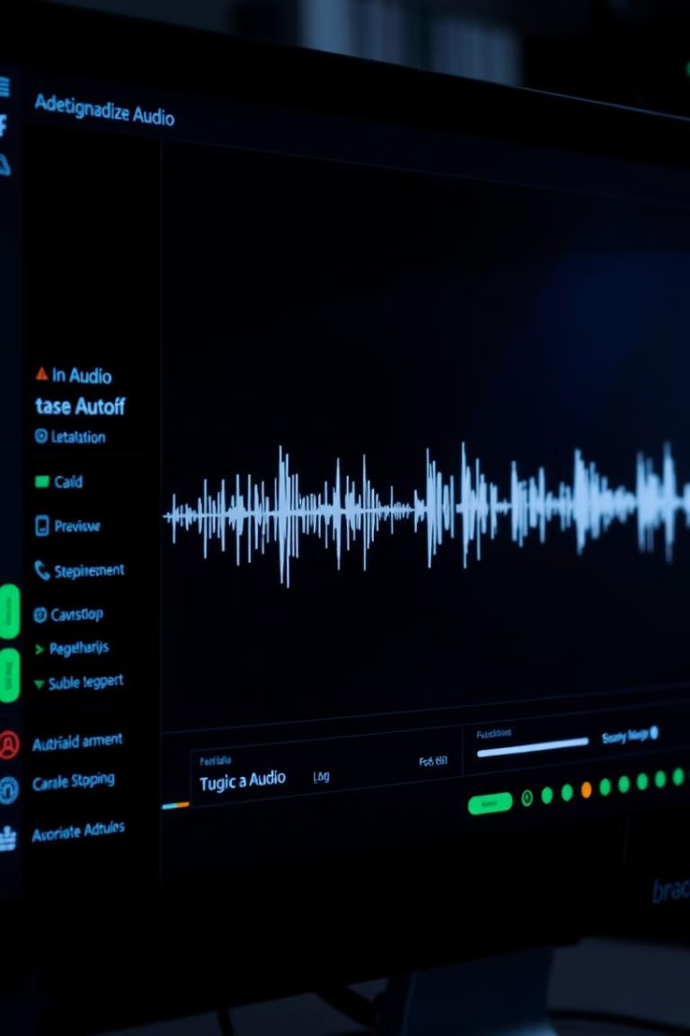
Feature Extraction: Unveiling the Secrets of Audio
Mel-Frequency Cepstral Coefficients (MFCCs)
Zero-Crossing Rate
The zero-crossing rate measures how often the audio signal crosses the zero axis. It's particularly useful for detecting changes in speech patterns, which can be indicative of different emotions.
MFCCs capture the spectral envelope of audio, representing the distribution of energy across different frequencies. They are a robust feature for capturing the unique characteristics of human speech.
Spectral Centroid
The spectral centroid represents the center of mass of the audio spectrum. It provides a measure of the overall brightness or darkness of a sound, which can be related to different emotions.

Slide 6
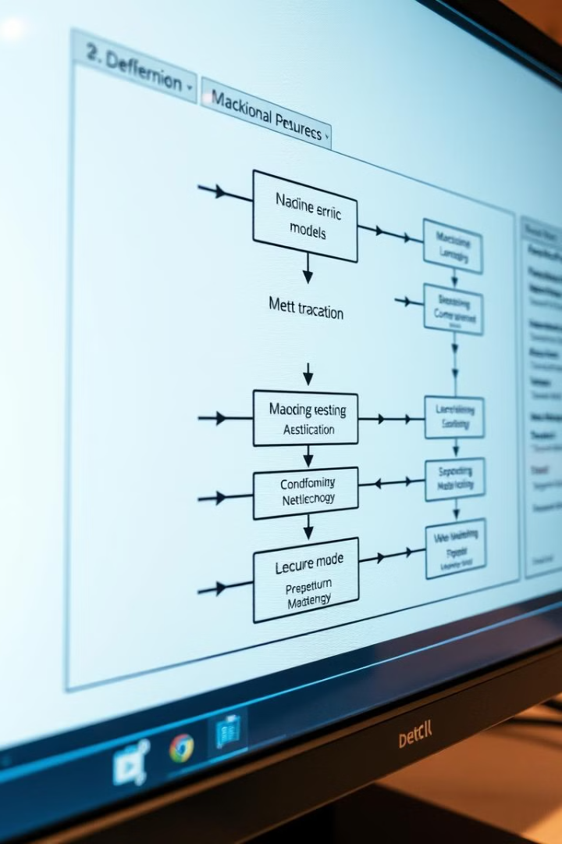



Choosing the Right Tools: Machine Learning Models
Neural Networks
Deep learning models, particularly convolutional neural networks (CNNs), excel at extracting complex patterns from audio data, making them ideal for sentiment classification.
Decision Trees
Decision trees provide a transparent and interpretable approach to classification. They make decisions by splitting the data based on specific features, offering insight into the model's reasoning.
Support Vector Machines (SVMs)
SVMs are powerful classifiers that find optimal hyperplanes to separate data into different classes. They are effective for handling high-dimensional data, often encountered in audio analysis.

Slide 7

Training and Evaluation: Refining Our Model
Splitting the Dataset
We divide our dataset into three parts: training data for model training, validation data for tuning model parameters, and test data for evaluating the model's performance on unseen data.
Hyperparameter Optimization
We optimize the model's hyperparameters using the validation data, ensuring the model performs well on unseen data.
1
2
3
4
Model Training
Performance Evaluation
We train our chosen machine learning model on the training data, allowing it to learn the patterns associated with different emotions.
We evaluate the model's performance on the test data using metrics such as accuracy, precision, recall, and F1 score.
Note: Hyperparameter optimization was implemented in our code; however, it did not yield the desired results. As a result, the code for this optimization has not been included in the Jupyter notebook.

Slide 8
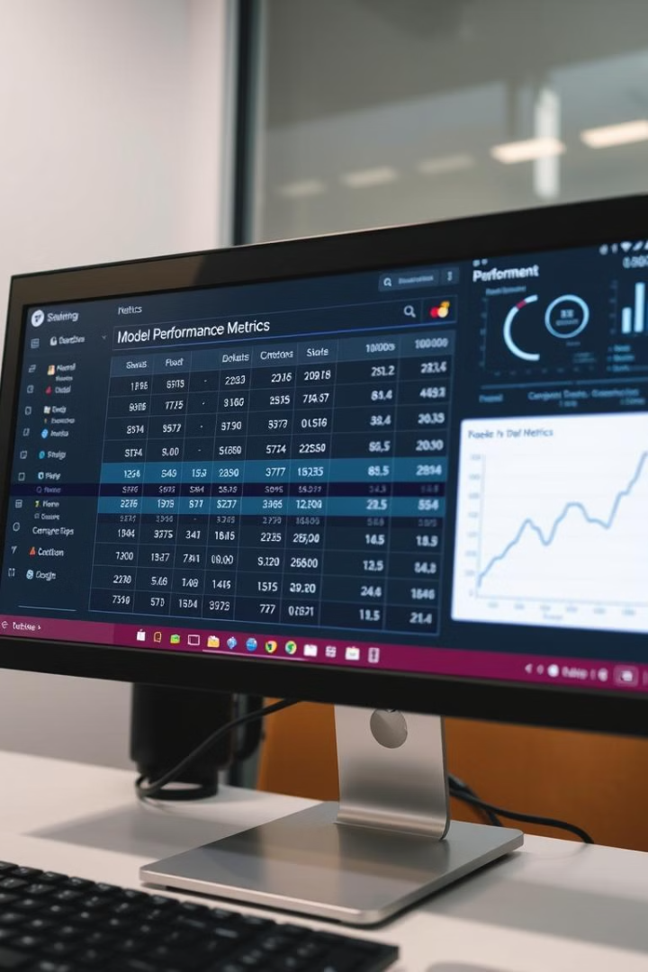
Best Model Evaluation:
LSTM Model
78%
66%
Accuracy
Precision
The accuracy of our model indicates its ability to correctly predict the sentiment of audio files. A high accuracy score suggests a model that is generally reliable.
Precision measures the model's ability to correctly identify a specific emotion, minimizing false positives. A high precision score is crucial for applications where accuracy is paramount.
78%
71%
Recall
F1 Score
Recall measures the model's ability to capture all instances of a particular emotion, minimizing false negatives. High recall is essential for applications where detecting all cases of a specific emotion is critical.
The F1 score is a metric used to evaluate the performance of a classification model. It is the harmonic mean of precision and recall, providing a single score that balances both of these measures

Slide 9
Comparative Analysis of Alternative Models
CNN Model
Combined Neural Network (CNN+RNN)
75%
Accuracy
49%
Accuracy
64%
Precision
44%
Precision
75%
Recall
40%
Recall
68%
F1 Score
42%
F1 Score
Decision Tree Model
Support Vector Method (SVM)
27%
15%
Accuracy
Accuracy
35%
8.9%
Precision
Precision
27%
15%
Recall
Recall
22%
8.4%
F1 Score
F1 Score

Slide 10




Deployment and Applications: Bringing Sentiment to Life
Google Collab
Customer Service
Social Media Monitoring
Mental Health Support
I made a Python-based framework for audio emotion prediction, designed for use within Google Collaboratory. It leverages an LSTM model trained on audio features (MFCCs) to identify emotions like happy, sad, angry, etc., from sound files.
Our sentiment detection model can be integrated into customer service systems to analyze customer calls or online feedback, providing insights into customer satisfaction and identifying areas for improvement.
We can use the model to analyze audio content from social media platforms, providing insights into public sentiment and identifying potential trends or issues.
The model could potentially assist in mental health applications, helping to identify individuals at risk of depression or anxiety based on their speech patterns.

Slide 11
Looking Forward: Future Directions and Possibilities
Multilingual Support
1
Extending our model to handle multiple languages would significantly broaden its applicability, making it valuable across diverse markets and demographics.
Real-Time Analysis
2
Developing real-time sentiment analysis capabilities would allow for dynamic and immediate insights into human emotions, opening up opportunities for interactive applications and personalized experiences.
Contextual Understanding
3
Integrating contextual information, such as the surrounding text or visuals, could help the model understand the nuances of sentiment within a broader context, leading to more accurate and insightful predictions.
Sentiment detection by audio analysis is a rapidly evolving field with immense potential to transform industries and improve human lives. By exploring the power of data science and machine learning, we can unlock a deeper understanding of human emotions, leading to more effective communication, personalized experiences, and better support for mental well-being.

